Slide 1
THYROID THREATS
Part 1
by
Coralie Phillips BSc (Hons) MSc
& Donna Roach BSc (Hons) MSc
Identical twin authors of
‘Hypothyroidism in Childhood and Adulthood’
and ‘Three Times the Trouble’
© 2013 by C Phillips and D Roach (except for the ClipArt which was provided within the Microsoft PowerPoint package)

Slide 2
Disclaimer
The information contained in this presentation relates to the individual experiences of the authors and should not be used to diagnose disease or prescribe medicine and the authors and anyone involved in the production of this presentation assume no responsibility for such action. Anyone requiring diagnosis, monitoring or treatment should always consult a qualified medical doctor on an individual basis. This is not a medical presentation.

Slide 3
Outline of This Presentation
Introduction
Section A - Our experiences of hypothyroidism in childhood
Section B - Our experiences of under treated hypothyroidism in adulthood

Slide 4
Introduction
We wish to share our experiences of hypothyroidism in order to raise awareness about this condition.

Slide 5
Section A
Our experiences of hypothyroidism in childhood

Slide 6
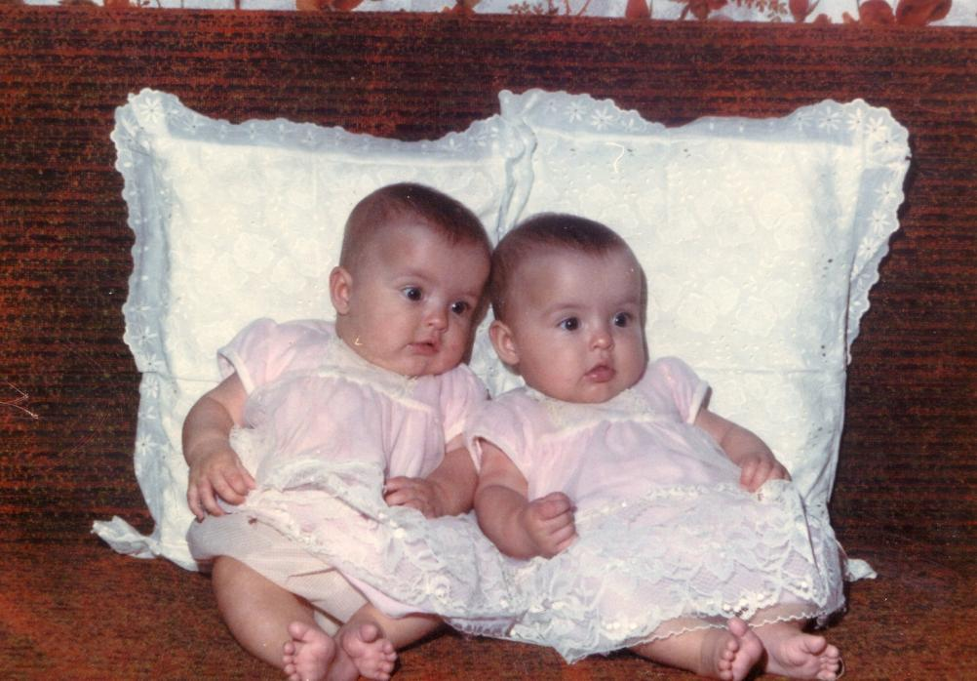
Section A
Photograph 1 – We are identical twins, here is a photograph of us at about 6 months of age.

Slide 7
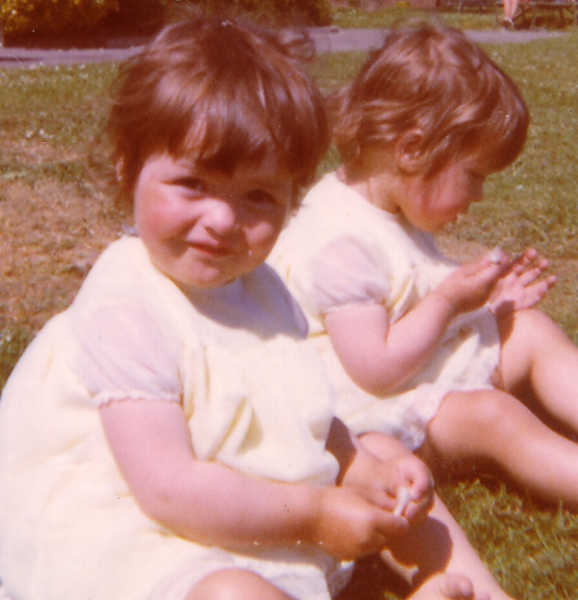
Section A
Photograph 2 – In this photo we are approximately 1 and ½ years of age.

Slide 8
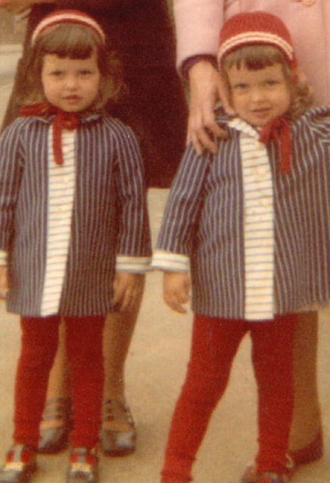
Section A
Photograph 3 – Here we are about 3 and ½ years of age.

Slide 9
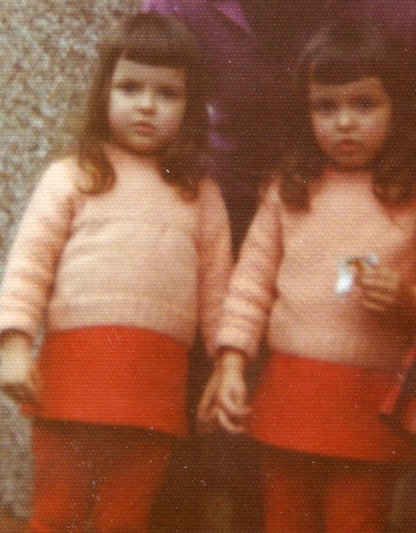
Section A
Photograph 4 – In this photograph we are approximately 4 years of age.

Slide 10
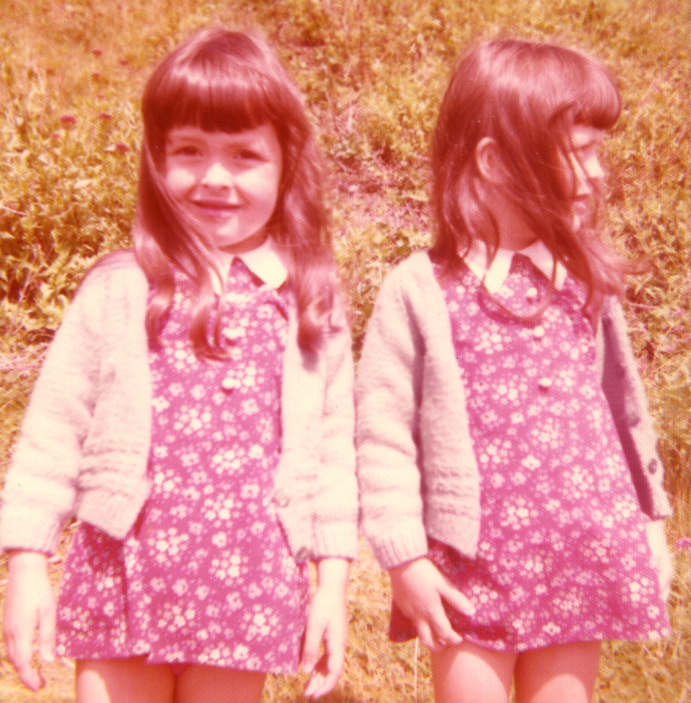
Section A
Photograph 5 – In this photo, we are about 5 years of age.

Slide 11
Section A
However, after the age of 5, my twin sister Donna began to develop symptoms including:
Fatigue, breathlessness, weight gain, lack of growth and development, delayed dental development and great difficulty with school work

Slide 12
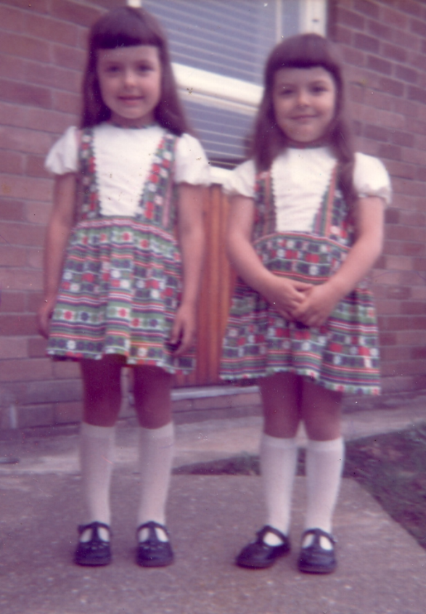
Section A
Photograph 6 – In this photo, we are 6 years of age. As can be seen, my twin sister Donna’s growth has slowed compared to mine. National Health Service (NHS) doctors mistakenly blamed my sister’s diet even though we were eating the same diet.

Slide 13
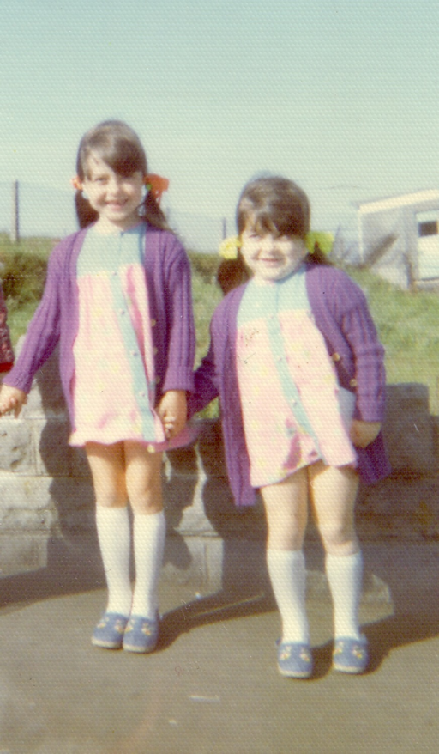
Section A
Photograph 7 – Here we are approximately 8 years of age. As you can see my twin sister Donna has stopped growing and I (Coralie) have continued to grow.

Slide 14
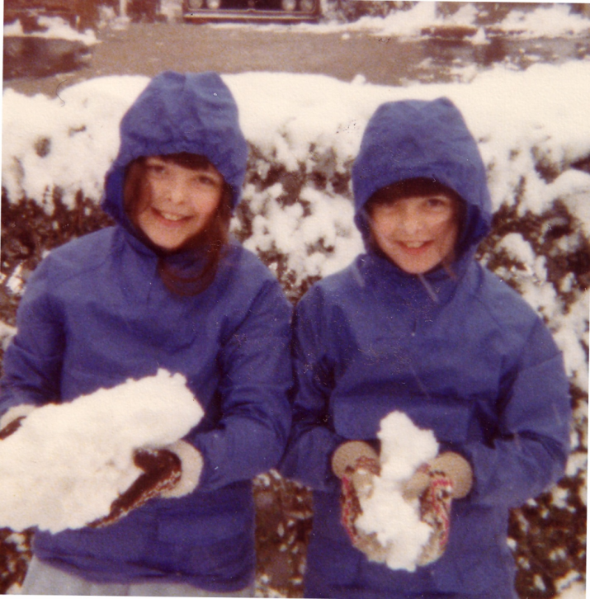
Section A
Photograph 8 – Here we are at about 9 years of age. Following diagnosis of hypothyroidism by our NHS paediatrician and treatment with thyroxine, my twin sister Donna’s growth is catching up with mine.

Slide 15
Section A
Although hypothyroidism had a dramatic effect on my identical twin sister in comparison to myself, if someone had looked at my twin sister without looking at me, the impact of hypothyroidism would have been less obvious!

Slide 16
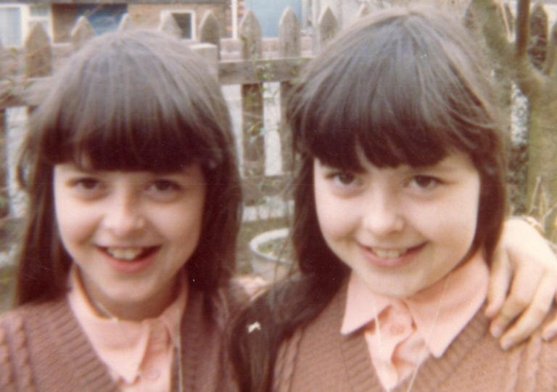
Section A
Photograph 9 – At about age 10, I (Coralie) started to develop symptoms of hypothyroidism. In this photo you can see that I (Coralie) have started to gain weight.

Slide 17
Section A
I (Coralie) developed the following symptoms of hypothyroidism:
Fatigue
Breathlessness
Weight gain
Fortunately, a diagnosis of hypothyroidism by our NHS paediatrician and thyroxine treatment led to recovery.

Slide 18
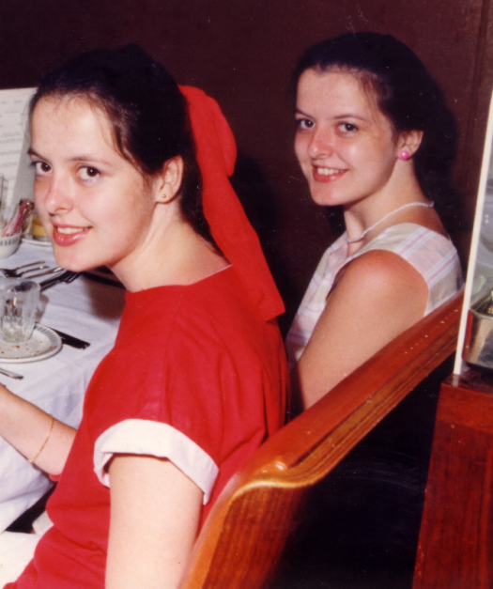
Section A
Photograph 10 – In this photo, we are about sixteen years of age. You can see that our thyroxine treatment enabled us to regain normal development.

Slide 19
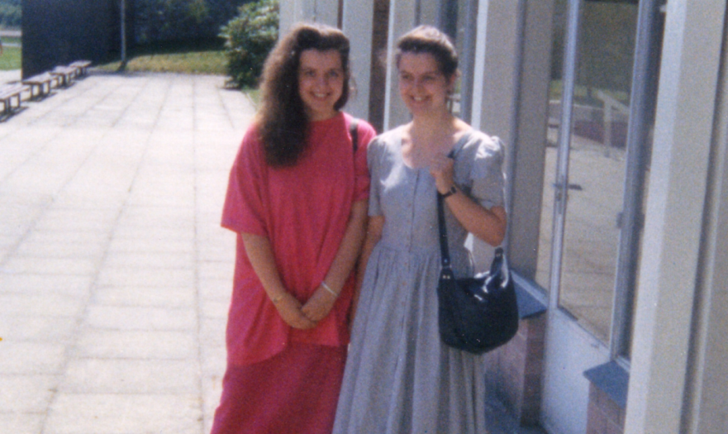
Section A
Photograph 11 – Here is a photo of us at 21 years of age, the year we both graduated from university with a 2.1 Bachelor of Science degree with honours.

Slide 20
Section B
Our experiences of under treated hypothyroidism in adulthood

Slide 21
Section B
In our early thirties, even though we were working and felt well, our blood test results prompted NHS doctors to halve our daily thyroxine dose.

Slide 22
Section B
We developed symptoms of hypothyroidism such as:
Fatigue
Breathlessness
Hand, wrist & forearm pain
Weight gain despite reduced appetite
Cold sensitivity
Headaches
Chest pains
Nausea, retching & severe balance problems

Slide 23
Section B
We continued to suffer from symptoms of hypothyroidism. An eventual rise in our thyroid stimulating hormone (TSH) levels above the reference range led to our thyroxine dose being increased to ¾ of the original dose. On ¾ of the original dose of thyroxine, our TSH levels were at the lower end of the reference range but we continued to suffer from severe symptoms of hypothyroidism!

Slide 24
Section B
We were unable to function but despite our deterioration, our low TSH levels meant that our doctors considered us to be on the correct dose of thyroxine and were unwilling to increase our thyroxine dose to its original level. We were rendered unable to function due to the exhaustion, carpal tunnel syndrome, balance problems and chest pains.

Slide 25
Section B
It is of concern that in our case there was not a consistent correlation between our symptoms of hypothyroidism and our TSH levels. This possibility needs to be recognised.

Slide 26
Section B
Much time passed before we succeeded in finding a doctor who was able to help us find the optimal thyroid treatment for our individual needs.

Slide 27
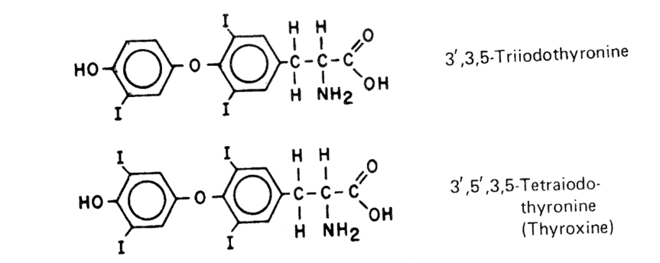
Section B
Our prescribed thyroid treatment was carefully adjusted in the order listed:
An increase in our thyroxine (T4) dose
The inclusion of tri-iodothyronine (T3) with our thyroxine treatment
Provision of Natural Desiccated Thyroid treatment (NDT)

Slide 28
Section B
As our prescribed thyroid treatment was adjusted, our physical and mental wellbeing improved. Eventually we were prescribed Natural Desiccated Thyroid treatment on its own. Although we had found thyroxine to be satisfactory for many years, in our case it was necessary for our treatment to be changed to Natural Desiccated Thyroid treatment in order for us to recover from under treated hypothyroidism. This possibility also needs recognition.

Slide 29
Section B
The prescription of Natural Desiccated Thyroid treatment was targeted to our individual needs. This enabled us to recover.

Slide 30
Section B
We have written about our experiences in our factual book ‘Hypothyroidism in Childhood and Adulthood’, which was published by Nottingham University Press in 2006.

Slide 31
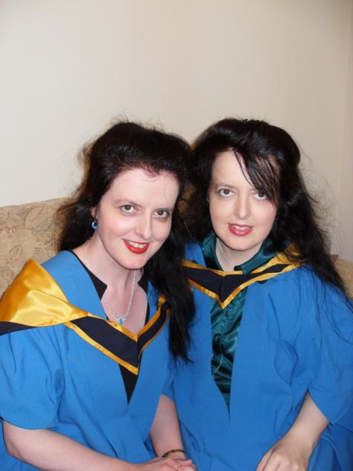
Section B
Since our recovery, we have both obtained a Master of Science degree in Science. We both graduated in 2012. Here is a photo of us after our graduation ceremony in 2012 at age 44. I (Coralie) have a green blouse.

Slide 32

Section B
We have also released a romantic novel ‘Three Times the Trouble’, which is available as a paperback and as a Kindle book via Amazon.
Although, it is a work of fiction, the impact of hypothyroidism upon some of the fictional characters is outlined.

Slide 33
Thank you
Thank you for taking the time to look at this presentation. Please see Thyroid Threats Part 2 for an outline of the findings of our Master of Science projects.
Our website is www.thyroidbooks.co.uk
Follow us on Twitter @Thyroid_Twins

