Slide 1
THYROID THREATS
Part 2
by
Coralie Phillips BSc (Hons) MSc
& Donna Roach BSc (Hons) MSc
Identical twin authors of
‘Hypothyroidism in Childhood and Adulthood’
and ‘Three Times the Trouble’
© 2013 by C Phillips and D Roach (except for the ClipArt which was provided within the Microsoft PowerPoint package)

Slide 2
Disclaimer
The information contained in this presentation relates to the individual experiences of the authors or to their academic work and should not be used to diagnose disease or prescribe medicine and the authors and anyone involved in the production of this presentation assume no responsibility for such action. Anyone requiring diagnosis, monitoring or treatment should always consult a qualified medical doctor on an individual basis. This is not a medical presentation.

Slide 3
Introduction
We are identical twin sisters and we both experienced hypothyroidism in childhood and under treated hypothyroidism in adulthood.
Fortunately, we eventually found a doctor who was able to provide us with the optimal thyroid treatment for our individual needs.

Slide 4
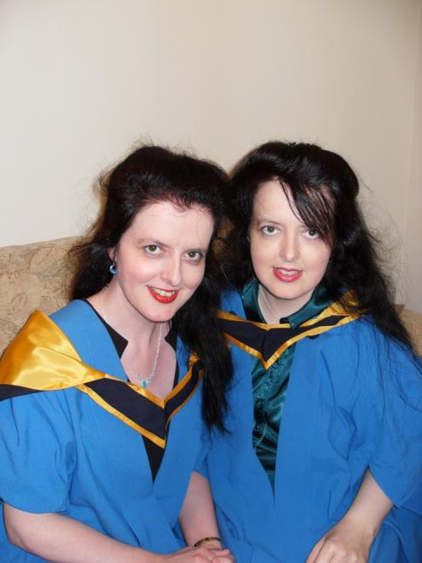
Introduction
Since our recovery, we have both obtained a Master of Science degree in Science. We both graduated in 2012. Here is a photo of us after our graduation ceremony in 2012 at age 44. I (Coralie) have a green blouse.

Slide 5
Introduction
In Section A, Coralie Phillips will outline the findings of her Master of Science Project.
In Section B, Donna Roach will provide an overview of her Master of Science Project.

Slide 6
Section A
The Master of Science Project
by Coralie Phillips
entitled
‘Controversy concerning the diagnosis and treatment of hypothyroidism:
Stakeholders’ views and recommendations’

Slide 7
Section A
A literature search was undertaken and interviews were carried out and questionnaires were distributed in order to find out the views of a sample of individuals involved in providing information and/ or support to members of the public with hypothyroidism (via charities/ voluntary organisations/ patient support groups)

Slide 8
Section A
27 individuals providing information and/or support to members of the public with hypothyroidism were interviewed or completed a questionnaire. I would like to thank the individuals concerned for their participation.

Slide 9
Section A
The identities of the individuals and groups who participated or chose not to participate have not been provided so that they remain anonymous.

Slide 10
Section A
Some concerns that have become apparent on the basis of responses/ types of responses provided by respondents will be outlined (although all of the concerns were not expressed by all of the respondents)

Slide 11
Section A
There is concern that the way that hypothyroidism is being diagnosed within the National Health Service (NHS) is inadequate with undue reliance on the tests for thyroxine (T4) and thyroid stimulating hormone (TSH) levels and that many test aren’t carried out at all and clinical evaluation is not carried out/ given full consideration and that as a result, many individuals with hypothyroidism remain undiagnosed or are misdiagnosed.

Slide 12
Section A
Concerns were also raised about the way that hypothyroidism is being monitored within the NHS, with some fearing that monitoring is inadequate with undue reliance on the T4 test and TSH test and that many tests are not carried out at all and clinical evaluation is not carried out/ given full consideration and that as a result many individuals with hypothyroidism are under treated. Again views vary on this issue.

Slide 13
Section A
There is concern that T4 is not adequate for the recovery of some individuals with hypothyroidism but that treatments such as a thyroxine/ tri-iodothyronine (T3) combination and/ or Natural Desiccated Thyroid (NDT) treatment which are required for the full recovery of certain individuals are not always being made available via the NHS and that as a
result, many are mistreated.

Slide 14
Section A
There is concern that private doctors who treat each patient as an individual and diagnose and treat their hypothyroidism and restore their health even if this means going outside of the guidelines are being threatened with action by the General Medical Council.

Slide 15
Section A
The majority of respondents thought that more research would help to resolve controversy concerning the diagnosis and treatment of hypothyroidism but some expressed concern that appropriate research is either not funded, not undertaken, inadequately designed or ignored.

Slide 16
Section A
The majority of respondents thought that more dialogue would help to resolve controversy concerning the diagnosis and treatment of hypothyroidism but some expressed concern that the attitudes of the medical profession and guideline producers would make it unlikely to take place or that if it did take place, patients would be inadequately represented and/ or their views dismissed.

Slide 17
Section A
The method of dialogue suggested by many of the participants was some form of face to face meeting.

Slide 18
Section A
If dialogue should take place, the desired outcomes included an improvement in the quality, quantity and relevancy of research, an improvement in guidelines so that each individual’s needs are met, understanding and respect for patients, improvements in diagnosis so that it was no longer based upon blood tests only and a recognition that some patients need T4/T3 and/ or NDT.

Slide 19
Section A
Recommendations regarding the need for research:
In light of feedback from one of the respondents in particular and many of the respondents in general, it is recommended that future research should include an evaluation of patients’ perspectives and preferences on a consistent basis.

Slide 20
Section A
Recommendations regarding the need for dialogue:
If dialogue should take place in the future, it would be important that some of the suggestions that have been made by respondents are utilised e.g. that a range of stakeholder groups are invited.

Slide 21
Section B
The Master of Science Project
by Donna Roach
entitled
‘Artificial fluoridation: Standpoints of selected stakeholders with reference to public engagement’

Slide 22
Section B
The aim of this project was to gain an understanding of the stance taken by selected stakeholders with regard to artificial fluoridation of the water supply. This was investigated by means of both literature review and interviews. There were 32 respondents in total. I am grateful to the respondents for their participation.

Slide 23
Section B
The stakeholders selected were stakeholders who were in favour of artificial fluoridation (proponents) and stakeholders who were against artificial fluoridation (opponents). The identities of those who participated or declined to participate have not been provided in order that they remain anonymous.

Slide 24
Section B
Divergences in views existed between proponents and opponents regarding the safety and efficacy of artificial fluoridation, with proponents indicating a level of trust in its safety and efficacy but with opponents expressing concerns about potential risks of this measure and questioning its efficacy. Each comment was not necessarily expressed by each interviewee in either group.

Slide 25
Section B
Participants were asked, ‘Are you satisfied with current levels of public involvement regarding the issue of artificial fluoridation? (e.g. yes/ no/ I don’t know)’

Slide 26
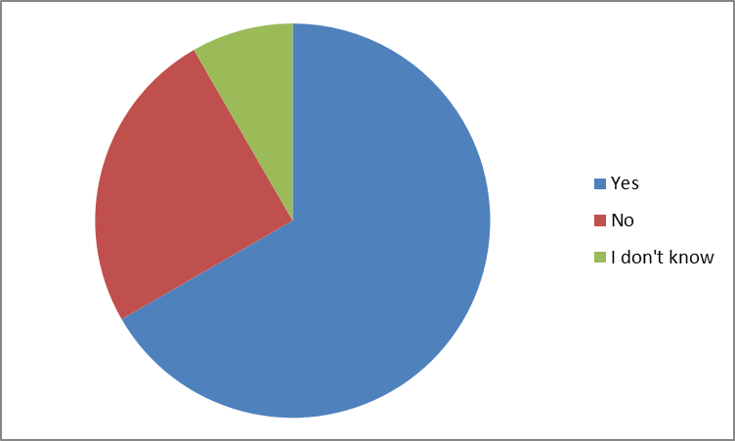
Section B
Results for proponents – Most of those in favour of artificial fluoridation were satisfied with current levels of public involvement regarding this issue.

Slide 27
Section B
Results for opponents – Most of those in opposition to artificial fluoridation were dissatisfied with current levels of public involvement regarding this issue.

Slide 28
Section B
With regard to interviews with opponents, opponents expressed concerns about the safety of fluoride even at low levels.

Slide 29
Section B
Amongst the numerous concerns and health concerns raised by opponents of artificial fluoridation, specific concerns were expressed regarding an association between fluoride and hypothyroidism.

Slide 30
Section B
Both proponents and opponents mentioned the need for improvements in the information that was available to the public regarding artificial fluoridation and for this information to be balanced.

Slide 31
Section B
The importance of public consultations was commented upon by some of the proponents and opponents. Some of the opponents interviewed in this study favoured public participation but comments were made regarding the importance of the views of the public being taken into account following public consultations.

Slide 32
Thank you
Thank you for taking the time to look at this presentation.
Please see Thyroid Threats Part 1 for an outline of our experiences of hypothyroidism in childhood and under treated hypothyroidism in adulthood.

Slide 33
Thank you
Please see our website www.thyroidbooks.co.uk
For more details about our Master of Science project findings
For information about our factual book ‘Hypothyroidism in Childhood and Adulthood’ (about our experiences of hypothyroidism)
For information about our romantic novel ‘Three Times the Trouble’ (which highlights the impact of hypothyroidism upon some of the fictional characters within the story)
Follow us on Twitter @Thyroid_Twins

